Slide 1
Teaching Resources on Asia: Introducing the Asia Pacific Curriculum Project
Erin Williams
Asia Pacific Foundation of Canada
Notes:
This is a PowerPoint template designed for BCCIE Summer Conference 2018 presentations. Please customize the slides to suit your presentation needs.
Header Font: Arial
Text Font: Arial
Eastern Blue: RGB 15 134 152
Light Sea Green: RGB 48 187 165
Cobalt: RGB 18, 83, 168
If you have questions about this template, please contact Vivien Lee (Coordinator, Digital Marketing and Programs) at vlee@bccie.bc.ca with subject header [2018 Summer Conference Template – Name]
---
Colour names source example: http://www.htmlcsscolor.com/hex/1253A8

Slide 2
Erin Williams Program Manger Skills and Competencies erin.williams@asiapacific.ca
Hello
Asia Pacific Foundation of Canada
Notes:
SELF INTRODUCTION
Change presenter photo
Double click on the photo
In the navigation panel (top bar), in the “Adjust” section choose “Change Picture”
Upload your own photo
**If there are more presenters, copy and paste the picture and repeat steps 1-3

Slide 3
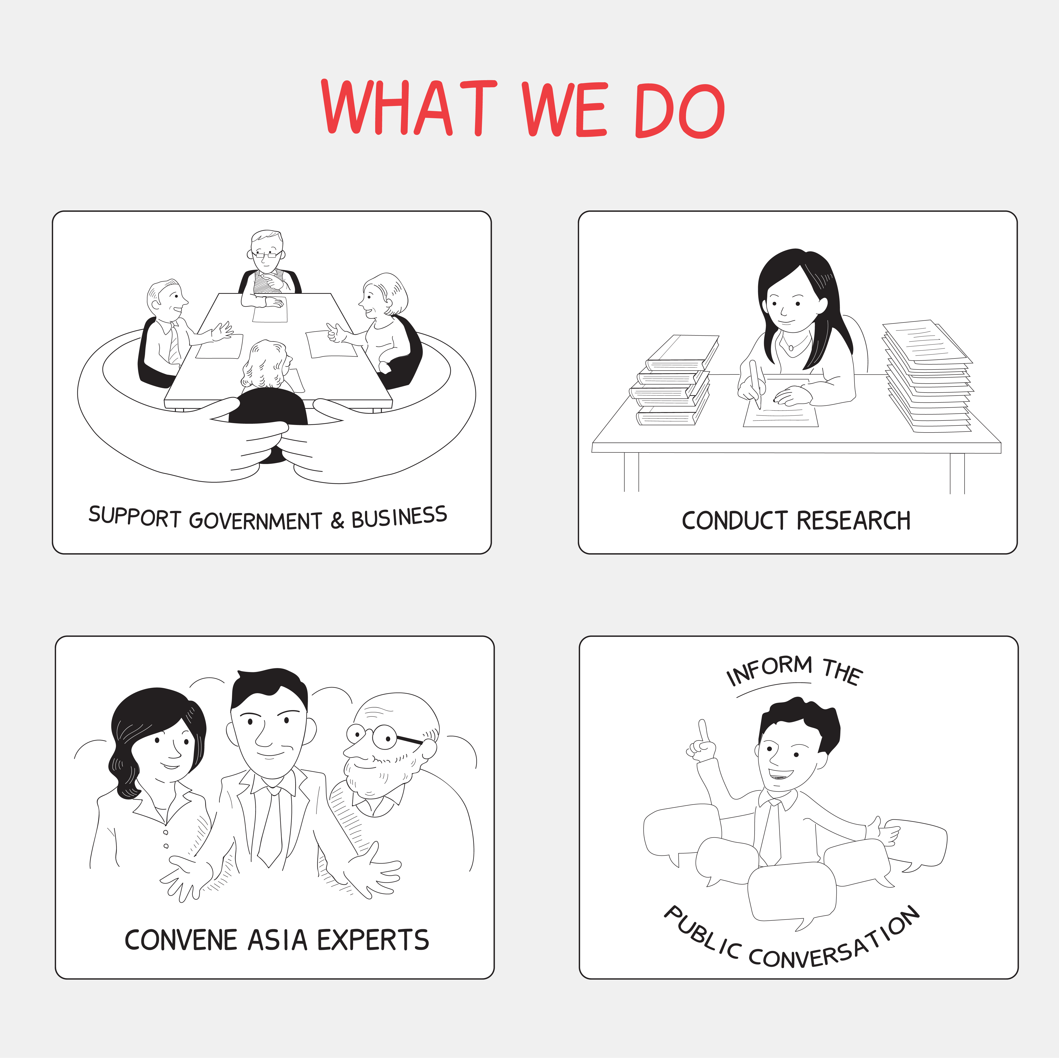
Asia Pacific Foundation of Canada
Asia Pacific Foundation of Canada is a not-for-profit organization focused on Canada's relations with Asia.
Our mission is to be Canada's catalyst for engagement with Asia and Asia's bridge to Canada. Our current themes are: • Promoting Trade, Investment, and Innovation • Building Skills and Competencies • Advancing Sustainability • Understanding Asia Now
Notes:
Duplicate this slide via copy and paste to create more slides with images.
Change photo
Double click on the photo
In the navigation panel (top bar), in the “Adjust” section choose “Change Picture”
Upload your own photo

Slide 4
Agenda
Youth
& Education
Who
What
Why

Slide 5
Youth & Education

Slide 6
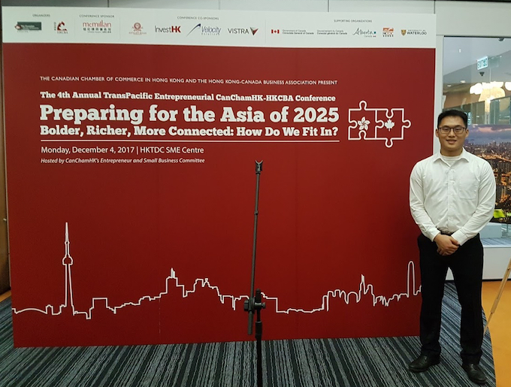
Internship in Asia
Hong Kong
India
Philippines
Others in process

Slide 7
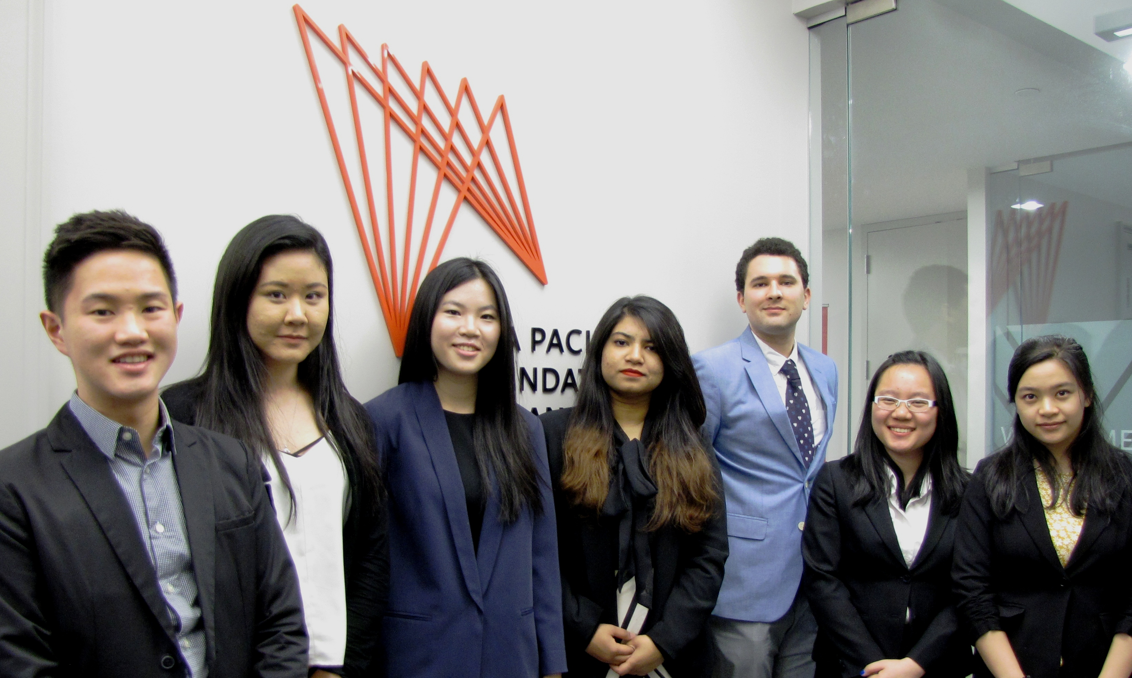
Asia Pacific Youth Council
Notes:
Duplicate this slide via copy and paste to create more slides with images.

Slide 8
Other Youth Initiatives
Asia Connect Student Working Groups
The Youth Element Podcast Series
Among Others

Slide 9
Asia Pacific Curriculum Project

Slide 10
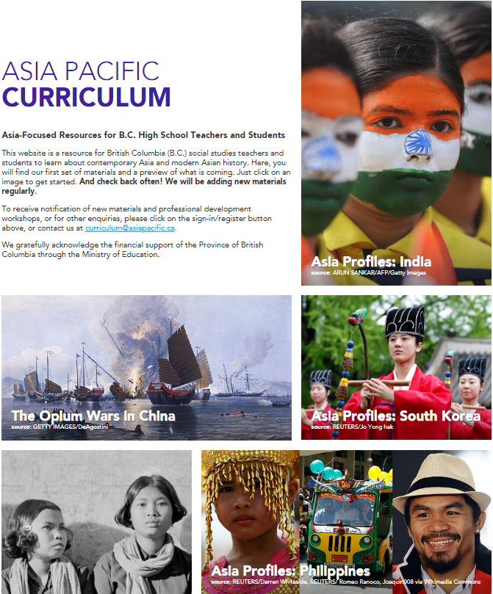
Asia Pacific Curriculum Project: Who
Three-year partnership with B.C Ministry of Education
Collaboration with the Critical Thinking Consortium, B.C. Social Studies Teachers Association

Slide 11
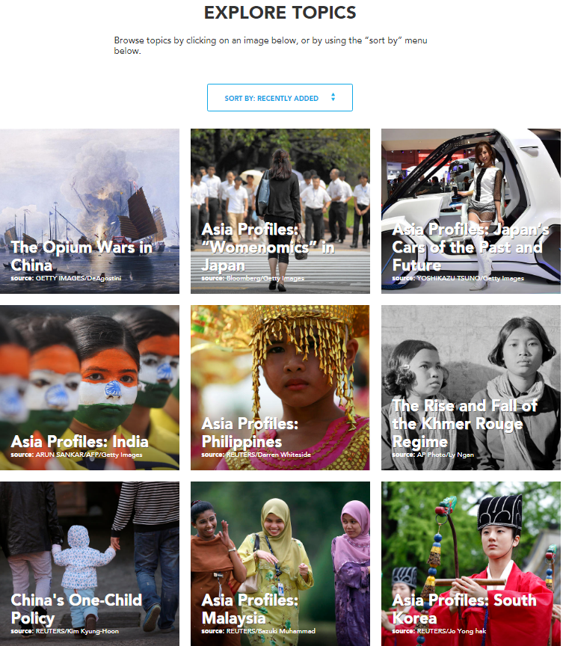
Asia Pacific Curriculum Project: What
Introduces B.C. student to Asia’s histories, geographies, trends of social and cultural change, politics, etc.
Focus on Grades 6, 9, 11-12
Teaching/learning materials + professional development workshops

Slide 12
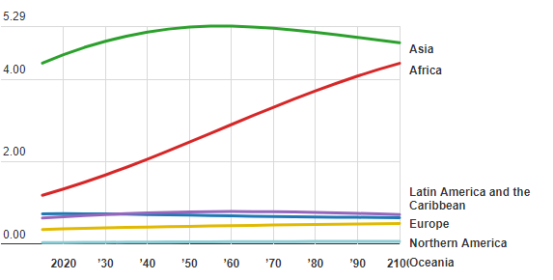
Asia Pacific Curriculum Project: Why
Population Projections (Billions, 2015 – 2100)
The World Bank Data Blog

Slide 13
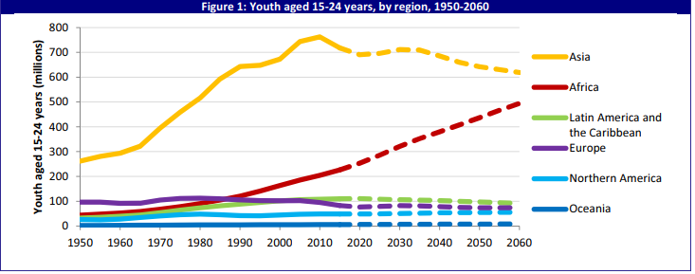
Asia Pacific Curriculum Project: Why
Youth Demographic
UN Population Facts 2015

Slide 14
Asia Pacific Curriculum Project: Why
Projected GDP in 2050
PwC The World in 2050

Slide 15
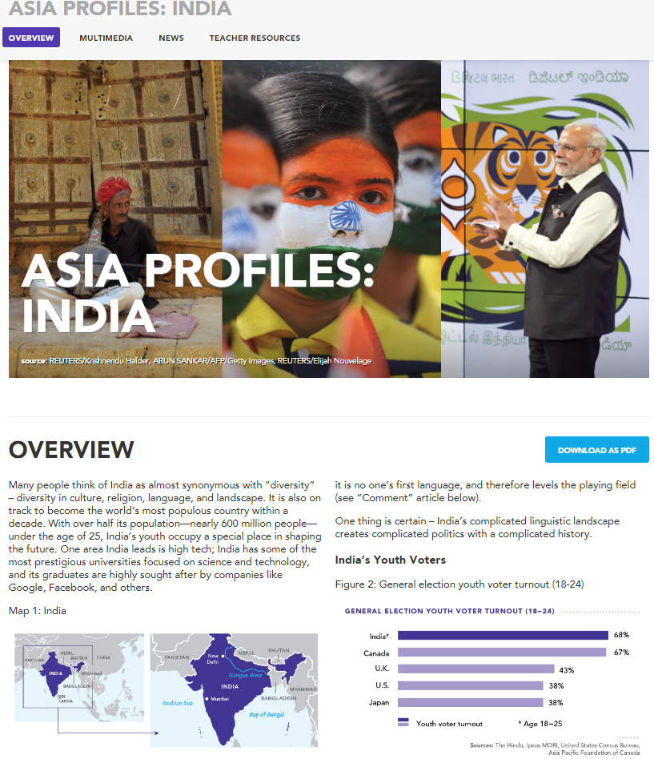
Asia Pacific Curriculum
Available topics June 2018
•Genocide and reconciliation in Cambodia (social justice, world history)
•China’s One-child Policy (human geography)
•China’s Opium Wars (world history)
•Japan’s ‘Womenomics’ (human geography, economics)
•Past and future of Japan’s car industry (economics)
•Asia Profiles series (Malaysia, Philippines, South Korea, India)
Notes:
https://asiapacificcurriculum.ca/

Slide 16
Asia Pacific Curriculum Coming Soon
2018-19
Grade 6 – Urbanization in Asia
Grade 6 – International Cooperation
Grade 9 – National identity (focus on Japan 19th and early 20th centuries)
Grade 9 – Migration (late 19th century Chinese migration)
2018-10
Grade 11-12 – Late 19th century Chinese migration (including internal)
Asia Profile: North Korea
Aboriginal peoples in Taiwan
Vietnam after the War
Introducing Japanese Culture

Slide 17
Other Resources on Asia
National Consortium for Teaching about Asia (U.S.) www.nctasia.org
Asia Education Foundation (Australia) www.asiaeducation.edu.au
World’s Largest Lesson – U.N. Sustainable Development Goals worldslargestlesson.globalgoals.org

Slide 18
Resources on B.C.’s Asian Canadian Communities and Histories
Bamboo Shoots: Chinese Canadian Legacies in B.C.: www.openschool.bc.ca/bambooshoots
Nikkei Stories (Japan): www.nikkeistories.com
Japanese Canadian History: www.Japanesecanadianhistory.net/historical-overview/general-overview
South Asian Canadian Heritage: www.southasiancanadianheritage.ca/pclp

Slide 19
Thank you
Any questions?
You can find me at
Erin.Williams@asiapacific.ca
Notes:
Please remember to add your contact information!

