Slide 1
University Mobility in Asia and the Pacific (UMAP)
What’s it all about?
Senior Manager, Internationalization & Market Support (BCCIE)
Chelsey Laird

Slide 2
Presentation Outline
Challenges and Opportunities for Canadians to study abroad
What is UMAP?
UMAP Programs
UMAP Scholarships
Membership Eligibility
UMAP Member Institution Experience – Coast Mountain College
Next Steps

Slide 3
Challenges for mobility
Some “typical” challenges to mobility identified by Canadian post-secondary institutions
Study abroad / mobility resources are limited;
Workload of international education offices high;
Strategic move away from multiple MOUs;
Student preference is short-term study abroad experience;
Students need financial support to go abroad;
Diversification of international student body;

Slide 4
An opportunity
UMAP Membership can provide a solution to many of the challenges identified by Canadian post-secondary institutions
Study abroad / mobility resources are limited;
Membership is free!
Workload of international education offices high;
Single online portal for inbound/outbound applications, scholarships, promotion of programs
Strategic move away from multiple MOUs;
Multilateral agreement (1) allowing access to post-secondary institutions in 18 countries

Slide 5
An opportunity
Student preference is short-term study abroad experience;
Various programs (traditional length; short term; summer camp; COIL-Honours)
Students need financial support to go abroad;
Scholarships offered by Japanese & Taiwanese government; eligibility for inbound students to apply for GAC scholarships
Diversification of international student body;
Inbound exchange students a strategic option to begin to build new market entry strategies

Slide 6
What is UMAP?
UMAP is an acronym for the “University Mobility in Asia and Pacific”.
Initiated in 1991, it is a voluntary association of government and non-government representatives of the higher education sector.
Its aim is to enhance international understanding by facilitating mobility of post-secondary students and faculty members within the Asia-Pacific region.
Notes:
Australia utilized the consortium to build national momentum around education abroad and mobility projects

Slide 7
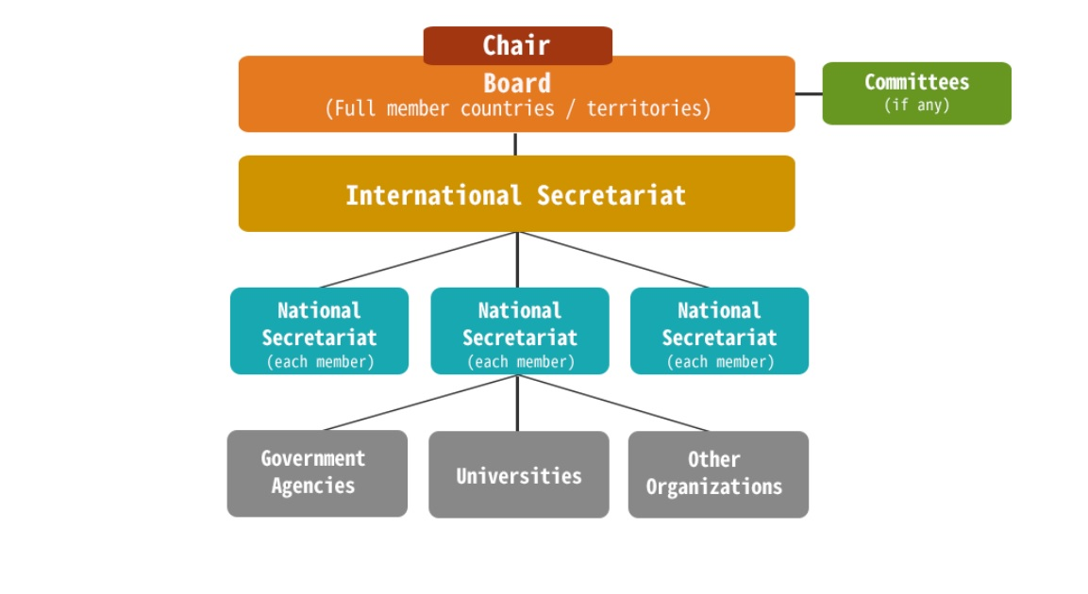
UMAP Organization
Notes:
The organization of UMAP is under the director of the Board of Directors. Each full country member (17 currently) have a representative on the Board and they meet twice a year. Dr. Randall Martin (Executive Director, BCCIE) is the Board member for Canada. The International Secretariat works directly with the board and is the main administrative unit of the UMAP Consortium. The International Secretariat is currently Toyo University in Japan. The International Secretariat roles and responsibilities include the management and administration of the day-to-day operations of UMAP programs (which we will discuss in a little bit) and serves as the liaison for the national secretariats.
BCCIE is the national secretariat for all Canadian members. The national secretariat role is the main point of contact in Canada and is responsible for the promotion and development of the UMAP Programs. The national secretariat role also includes vetting interested post-secondary institutions for UMAP membership.
BCCIE is encouraging all public and private post-secondary institutions in Canada to sign-up for this consortium. Participating schools must be a Designated Learning Institution (DLI) and have sufficient infrastructure for facilitating education abroad programs. There is no cost for Canadian post-secondary institutions to participate. The Canadian membership fee for UMAP has been paid for by BCCIE for all eligible Canadian post-secondary schools to participate.

Slide 8
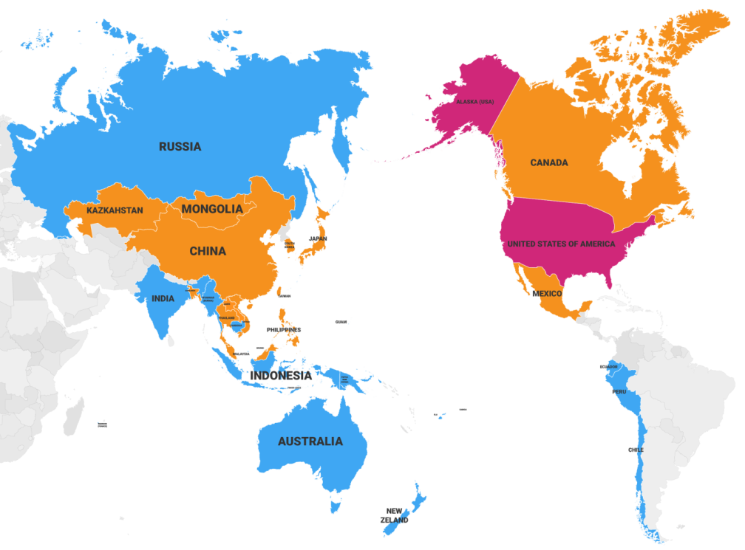
UMAP Members
UMAP comprises 35 eligible countries/territories.
Currently 230 institutions in 18 full member states are active.
Member Countries/Territories
Australia / Bangladesh / Brunei / Cambodia / Canada / Chile / People’s Republic of China / Ecuador / Fiji / Guam / Hong Kong / India / Indonesia / Japan / Kazakhstan / Republic of Korea / Laos / Macao / Malaysia / Mexico / Mongolia / Myanmar / New Zealand / Papua New Guinea / Peru / Philippines / Reunion Island / Russia / Samoa / Singapore / Taiwan / Thailand / Timor-Leste / USA (NY state) / Vietnam
Note:
Currently 18 states shown in orange among 35 eligible states are FULL members which participate in student exchanges by paying the membership fees.

Slide 9
UMAP Programs
Multilateral
Student Exchange Program A
Bilateral
Student Exchange
Program B
Discovery Camp (Summer)
Short-Term
Student Exchange
Program C
Research Collaboration
Program
COIL-Honours Program
Your Institution
More than 250 institutions

Slide 10
UMAP Programs
Multilateral Student Exchange (Program A)
Post-secondary institutions send and receive 2 students per semester.
Post-secondary institutions may accept more inbound students than 2 in return for extra ‘quotas’ to send more outbound students in the following semesters without any expiration date.
The host university waives tuition fees, and assists students in securing appropriate accommodations at a reasonable costs.
Programs can last one or two semesters, beginning in the fall or spring semester.
Notes:
Program A is a student exchange program in which UMAP institutions can send and receive two students per semester. Exchange are made on a tuition-waiver basis.

Slide 11
UMAP Programs
Bilateral Student Exchange (Program B)
A bilateral student exchange is a program developed by any two UMAP affiliated post-secondary institutions
Post-secondary institutions send and receive more than 2 students per semester.
Conditions for tuition waiver is dependent on host universities (ie. Fees may be charged, if mutually agreed to)
Programs at the undergraduate or post-graduate level can last one or two semesters, beginning in the fall or spring semester.
Notes:
Bilateral student exchange agreements can also be made between two institutions wishing to exchange more than two students.

Slide 12
UMAP Programs
Short-term Student Exchange (Program C)
Programs are generally offered from 1-8 weeks.
Programs are available in a wide range of disciplines:
cultural studies, language proficiency courses, vocational training, entrepreneurship, and more.
Post-secondary institutions offering Program C may charge tuition fees.
Host Post-secondary institutions decide whether or not to offer credits for Program C.

Slide 13
UMAP Programs
UMAP Discovery Camp
UMAP Discovery Summer camp organized by consortium members; hosting country rotates.
2019 - Taiwan
2020 – Malaysia
Program length (10+ days) in July or August; open to students from UMAP full country members; between ages of 18-23
All costs incurred during program in host country (accommodations, transportation, food, activities) are covered by the program
Students responsible for expenses to/from host country, insurance (travel and medical) and spending money.

Slide 14
Scholarship Opportunities (CAN)
Leveraging Global Affairs Canada (GAC) Scholarships
Canada-ASEAN Scholarships and Educational Exchanges for Development (SEED)
Eligible active UMAP countries: Brunei, Laos, Malaysia, Philippines, Singapore, Thailand, Vietnam
Emerging Leaders in the Americas (ELAP) Program
Eligible active UMAP countries: Chile, Mexico
Details
2 ways Canadian UMAP members can leverage GAC scholarships:
If you will be hosting a student from an UMAP member country eligible, you can use the UMAP Pledge of Agreement to meet MOU requirement;
If will be hosting a student under UMAP Program A (which waives tuition fees), you can apply for GAC scholarships for that student.

Slide 15
Scholarship Opportunities (UMAP)
Japanese Government Scholarship
(For short-term & semester-long)
Approx. $700USD/month for inbound students in Japan under UMAP programs.
Approx. $500-$900USD/month for Japanese outbound students under UMAP programs.
Taiwanese Government Scholarship
(For semester-long only)
Approx. $700USD/month for inbound students in Taiwan under UMAP programs.
Approx. $700USD/month for Taiwanese outbound students under UMAP programs.

Slide 16
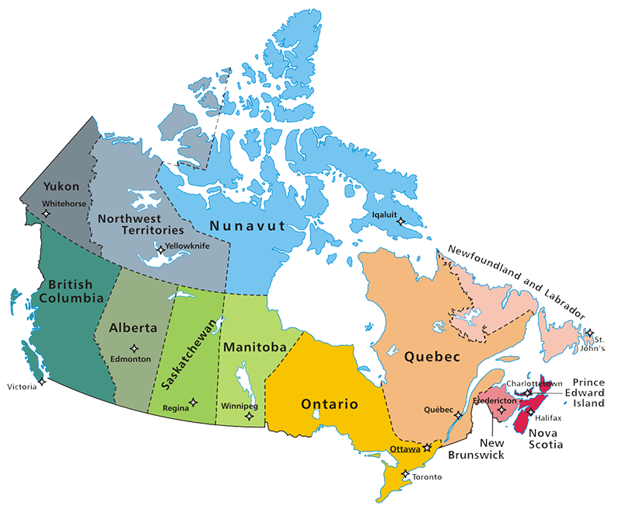
UMAP Membership
all Canadian public and private post-secondary institutions
Must be a Designated Learning Institution (DLI)
Must have sufficient infrastructure for facilitating education abroad programs
There is no membership fee for Canadian institutions!

Slide 17
Current Canadian Members

Slide 18
Current UMAP member
Hyeyoung Kang
International Program Coordinator

Slide 19
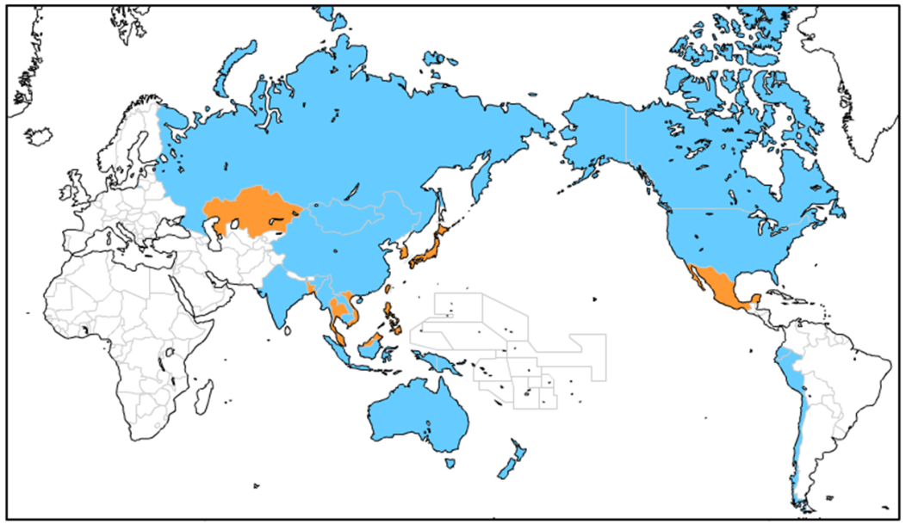
Next Steps – Join now!
UMAP comprises 35 eligible countries/territories.
Currently 230 universities in 18 full member states are active.
Member Countries/Territories
Canada joined UMAP March 2018.
We are seeking
Canadian member institutions.
Australia / Bangladesh / Brunei / Cambodia / Canada / Chile / People’s Republic of China / Ecuador / Fiji / Guam / Hong Kong / India / Indonesia / Japan / Kazakhstan / Republic of Korea / Laos / Macao / Malaysia / Mexico / Mongolia / Myanmar / New Zealand / Papua New Guinea / Peru / Philippines / Reunion Island / Russia / Samoa / Singapore / Taiwan / Thailand / Timor-Leste / USA / Vietnam
Note:
Currently 18 states shown in orange among 35 eligible states are FULL members which participate in student exchanges by paying the membership fees ($500-$4,000/year).

Slide 20
Join now!
3 Steps to Be an UMAP Member
Step-1: Inform National Secretariat
Inform BCCIE (UMAP National Secretariat in Canada) of your intention to be a UMAP member. ✉umap@bccie.bc.ca
Step-2: Contract “Pledge of Agreement” Sign the in order to participate in UMAP Programs. Please send two copies of the signed “Pledge of Agreement” to UMAP International Secretariat.
Step-3: Participate in UMAP Programs You can start student exchange through UMAP by participating UMAP Programs once you completed contract “Pledge of Agreement.”
No membership fees from individual institutions!

Slide 21
Resources
http://www.umap.org
Detailed information about application processes, programs available, participating institutions, model credit transfer scheme
http://bccie.bc.ca/umap/
Information specific to Canadian UMAP Members

Slide 22
Questions

Slide 23
Contact Information
BC Council for International Education (BCCIE)
UMAP National Secretariat (Canada)
Executive Director, Dr. Randall Martin
Senior Manager, Chelsey Laird
Email: umap@bccie.bc.ca

