Slide 1
International student data: Can we really count on it?
Steve Nerlich
Australian National University
Australian Government Department of Education and Training
Notes:
This is a PowerPoint template designed for BCCIE Summer Conference 2018 presentations. Please customize the slides to suit your presentation needs.
Header Font: Arial
Text Font: Arial
Eastern Blue: RGB 15 134 152
Light Sea Green: RGB 48 187 165
Cobalt: RGB 18, 83, 168
If you have questions about this template, please contact Vivien Lee (Coordinator, Digital Marketing and Programs) at vlee@bccie.bc.ca with subject header [2018 Summer Conference Template – Name]
---
Colour names source example: http://www.htmlcsscolor.com/hex/1253A8

Slide 2
our office
Notes:
Location circles can be moved according to your needs. Select with your mouse cursor, drag and drop to desired spot.

Slide 3
I am Director of an Australian data unit
Hello
I am also a PhD student - still…
It’s mid-winter in Australia.
Notes:
SELF INTRODUCTION
Change presenter photo
Double click on the photo
In the navigation panel (top bar), in the “Adjust” section choose “Change Picture”
Upload your own photo
**If there are more presenters, copy and paste the picture and repeat steps 1-3

Slide 4
My name is Inigo Montoya
Hello
You killed my father…
Prepare to die.
Notes:
SELF INTRODUCTION
Change presenter photo
Double click on the photo
In the navigation panel (top bar), in the “Adjust” section choose “Change Picture”
Upload your own photo
**If there are more presenters, copy and paste the picture and repeat steps 1-3

Slide 5
Purpose statement
There are many different data sources
They are all correct in, and of, themselves
There is no one truth: there are data definitions

Slide 6
How many incoming international students?
International students | Latest reported full-year data | % growth on previous year | Actual time period
USA | 1,078,822 | 3% | 2016-17
Australia | 624,001 | 13% | 2017
Canada | 494,525 | 20% | 2017
China | 442,773 | 11% | 2016
UK | 442,375 | 1% | 2016-17
Germany | 358,895 | 6% | 2017
Notes:
Give a brief overview of the presentation. Describe the major focus of the presentation and why it is important.
Introduce each of the major topics.
To provide a road map for the audience, you can repeat this Overview slide throughout the presentation, highlighting the particular topic you will discuss next.

Slide 7
How many incoming international students?
International students | Latest reported full-year data | % growth on previous year | Actual time period
USA | 1,078,822 | 3% | 2016-17
Australia | 624,001 | 13% | 2017
Canada | 494,525 | 20% | 2017
China | 442,773 | 11% | 2016
UK | 442,375 | 1% | 2016-17
Germany | 358,895 | 6% | 2017
But…
Australia is not second; and
Canada is not third.
Notes:
Give a brief overview of the presentation. Describe the major focus of the presentation and why it is important.
Introduce each of the major topics.
To provide a road map for the audience, you can repeat this Overview slide throughout the presentation, highlighting the particular topic you will discuss next.

Slide 8
An authoritative source of global data: UNESCO data
USA | 907,251 | 19.3%
UK | 430,687 | 9.2%
Australia | 294,438 | 6.3%
France | 239,409 | 5.1%
Germany | 228,756 | 4.9%
Russia | 226,431 | 4.8%
Canada | 171,603 | 3.7%
Japan | 131,980 | 2.8%
China | 123,127 | 2.6%
Malaysia | 111,443 | 2.4%
Rest of world | 1,832,105 | 39.0%
Total | 4,697,230 | 100%
Notes:
All countries listed have China as their number one source country except China and:
France: Morocco, then China
Russia: All top 10 countries are former USSR partners except China at No. 8 (and India is No. 11)
Malaysia: China is third after Bangladesh and Nigeria.

Slide 9
Source: http://uis.unesco.org/en/uis-student-flow
Notes:
Flow of tertiary student is mainly higher education and diploma level students (what we call VET).

Slide 10
Source: http://uis.unesco.org/en/uis-student-flow
Notes:
Flow of tertiary student is mainly higher education.

Slide 11
Source: http://uis.unesco.org/en/uis-student-flow
Notes:
Flow of tertiary student is mainly higher education.

Slide 12
UNESCO data – behind the scenes
Country | 2015 | 2016 | 2017
USA | 907,251 | ─ | ─
UK | 430,687 | ─ | ─
Australia | 294,438 | 335,512 | ─
France | 239,409 | ─ | ─
Germany | 228,756 | ─ | ─
Russia | 226,431 | 243,752 | ─
Canada | 171,603 | 189,573 | ─
Japan | 131,980 | ─ | ─
China | 123,127 | 137,527 | ─
Malaysia | 111,443 | 124,133 | ─
Whole world | 4,697,230 | 4,854,346 | ─
Notes:
2016 slowly being populated and already bigger than 2015.
The 2016 total is calculated as a rolling total

Slide 13
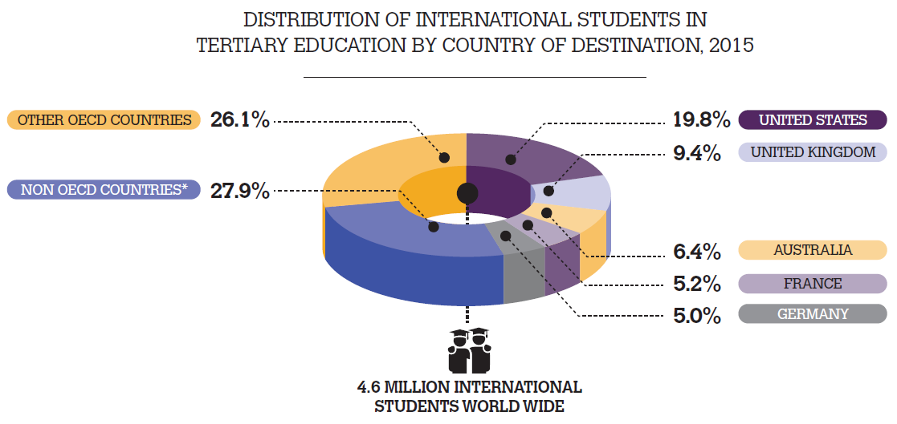
Data source: UNESCO
Notes:
UNESCO data captures students studying for a period exceeding 1 year in all levels of higher education, as well as diploma and advanced diploma courses (which may incorporate a small proportion of VET students)

Slide 14
How many incoming international students (2015)?
International students | 2015 data reported by countries | 2015 data reported by UNESCO | Actual time period
USA | 974,926 | 907,251 | 2014-15
Australia | 497,159 | 294,438 | 2015
Canada | 353,000 | 171,603 | 2015
China | 397,635 | 137,527 | 2015
UK | 436,485 | 430,687 | 2014-15
Germany | 321,569 | 228,756 | 2015
Notes:
Give a brief overview of the presentation. Describe the major focus of the presentation and why it is important.
Introduce each of the major topics.
To provide a road map for the audience, you can repeat this Overview slide throughout the presentation, highlighting the particular topic you will discuss next.

Slide 15
How many incoming international students (2015)?
International students | 2015 data reported by countries | 2015 UNESCO tertiary students | Actual time period
USA | 974,926 | 907,251 | 2014-15
Australia | 497,159 | 294,438 | 2015
Canada | 353,000 | 171,603 | 2015
China | 397,635 | 137,527 | 2015
UK | 436,485 | 430,687 | 2014-15
Germany | 321,569 | 228,756 | 2015
Notes:
Give a brief overview of the presentation. Describe the major focus of the presentation and why it is important.
Introduce each of the major topics.
To provide a road map for the audience, you can repeat this Overview slide throughout the presentation, highlighting the particular topic you will discuss next.

Slide 16
How many incoming international students (2015)?
International students | 2015 data reported by countries | 2015 UNESCO tertiary students | Actual time period
USA | 974,926 | 907,251 | 2014-15
Australia | 497,159 | 294,438 | 2015
Canada | 353,000 | 171,603 | 2015
China | 397,635 | 137,527 | 2015
UK | 436,485 | 430,687 | 2014-15
Germany | 321,569 | 228,756 | 2015
Country-reported numbers do not correspond with UNESCO data. They’re nearly always bigger.
Notes:
Give a brief overview of the presentation. Describe the major focus of the presentation and why it is important.
Introduce each of the major topics.
To provide a road map for the audience, you can repeat this Overview slide throughout the presentation, highlighting the particular topic you will discuss next.

Slide 17
Who aren’t tertiary students?
Australia: Includes school, English language, vocational certificate and incoming study abroad students.
USA: Includes English language, community college and optional practical training (work experience).
China: Includes language and cultural study students. Around half of China’s incoming students are non-award students.
Notes:
Give a brief overview of the presentation. Describe the major focus of the presentation and why it is important.
Introduce each of the major topics.
To provide a road map for the audience, you can repeat this Overview slide throughout the presentation, highlighting the particular topic you will discuss next.

Slide 18
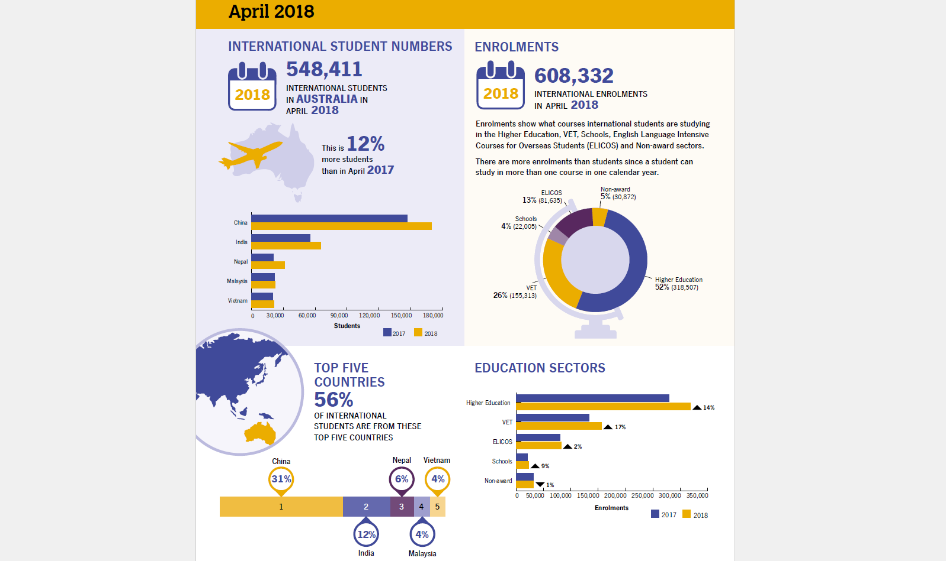
Monthly data releases
Notes:
How our

Slide 19
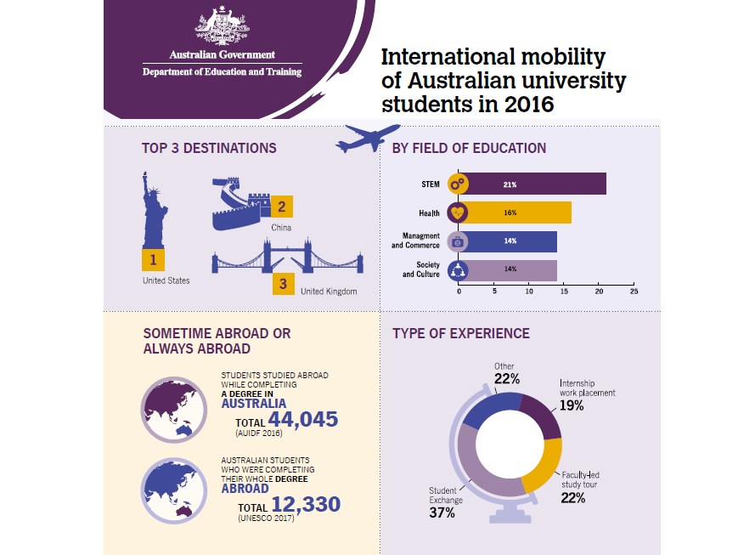
Outgoing student data

Slide 20
Outgoing mobility – UNESCO again
Australia: 38,144 students in 2015, while UNESCO says 12,330
USA: 313,415 students in 2014-15, while UNESCO says 68,580 (in 2015).

Slide 21
Outgoing mobility – UNESCO again
Australia: 38,144 students in 2015, while UNESCO says 12,330
USA: 313,415 students in 2014-15, while UNESCO says 68,580 (in 2015).

Slide 22
Outgoing mobility – UNESCO again
Australia: 38,144 students in 2015, while UNESCO says 12,330
USA: 313,415 students in 2014-15, while UNESCO says 68,580 (in 2015).
Most outgoing students from the USA and Australia are ‘credit mobility’. UNESCO numbers are ‘degree mobility’.

Slide 23
Outgoing mobility – UNESCO again
Australia: 38,144 students in 2015, while UNESCO says 12,330
USA: 313,415 students in 2014-15, while UNESCO says 68,580 (in 2015).
China: 523,700 students in 2015, while UNESCO says 847,259.
Most outgoing students from the USA and Australia are ‘credit mobility’. UNESCO numbers are ‘degree mobility’.

Slide 24
Outgoing mobility – UNESCO again
Australia: 38,144 students in 2015, while UNESCO says 12,330
USA: 313,415 students in 2014-15, while UNESCO says 68,580 (in 2015).
China: 523,700 students in 2015, while UNESCO says 847,259
Most outgoing students from the USA and Australia are ‘credit mobility’. UNESCO numbers are ‘degree mobility’.
Many students from China are ‘degree mobility’ already. China counts each year’s departures, UNESCO counts all departed.

Slide 25
Take home message
There are many different data sources
They are all correct in, and of, themselves
There is no one truth: there are data definitions
Notes:
So, don’t delete your data team’s caveats.

Slide 26
What else do countries report?

Slide 27
Student data makes us accountable to our students
A major education destination country needs:
Student experience data (customer satisfaction, safety and work experience)
University rankings (prestige, based on teaching and research excellence… and internationalization)
Graduate outcomes data (return on investment).

Slide 28
We do fact sheets too.

Slide 29
Thank you
Any questions?
You can find me (and us) at
steve.nerlich@education.gov.au
ieresearch@education.gov.au
You can find our data at:
internationaleducation.gov.au
Notes:
Please remember to add your contact information!

