Slide 1
Advancing internationalisation in complex political circumstances – some observations from Poland, Hungary and Czech Republic
Markus Laitinen, President, EAIE
BCCIE Summer Conference 18.6.2018

Slide 2
The EAIE [16:9 / 4:3] image with logo and maybe letters REMOVE template FEEL

Slide 3
Some political realities in Europe
Refugees, especially since 2015
Unwillingness to redistribute arriving refugees across EU
Heightened nationalism / EU-criticism
Czech Presidential Election 1/2018
Milos Zeman won on populist/anti-immigration platform
2017 parliamentary election won by Euro-critics
Hungarian parliamentary election 4/2018
Viktor Orban, Fidesz retained 2/3 majority
Case CEU
Poland
Law and Justice party in power, likely to continue after next elections in 2019
Civil liberties, justice system, rule of law under attack

Slide 4
Polish, Czech and Hungarian IHE
Declining demographics, brain drain
International students seen as part of a solution
Strong central IHE agencies
Country representation at NAFSA, EAIE, APAIE
Scholarship programmes for incoming students
Hungary: internationalisation audit of HEIs
Co-ordinated capacity building for practitioners
Poland: new agency established
English (and German) –taught programmes proliferating
Traditionally esp. medical sciences
High interest to increase # of international students
Both nationally and institutionally
Strong (outbound) student mobility
Institutional uptake in internationalisation differs quite a lot

Slide 5
EAIE Priority Countries
Stark realisations 2014
EAIE Strategy 2016-2020
“Work toward a more balanced European representation within the leadership, membership and wider community”
Decision to choose Poland, Czech Republic and Hungary
Actions
Trips to, and other forms of engagement with country stakeholders
EAIE Board assigned KPIs for priority country engagement
EAIE Academies in Warsaw and Prague
In-house/In-country training being activated

Slide 6
Hungary

Slide 7
Hungarian IHE
No national IHE Strategy
Internationalisation embedded in general HE strategy
National IHE priorities
Increase HEI competitiveness, especially in research
Increase mobility
goal for outgoing students 20%
goal for inbound students 40.000
Strengthen international collaboration
Also: curriculum development, student support, research and innovation
Programmes offered in English trebled 2014-2018

Slide 8
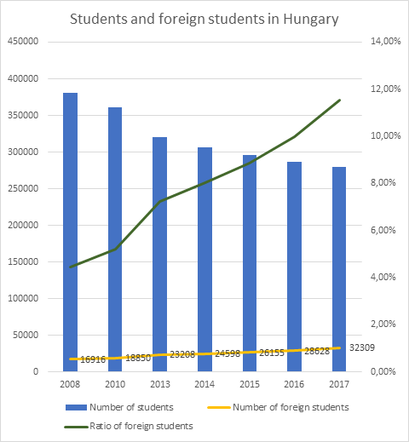

Slide 9
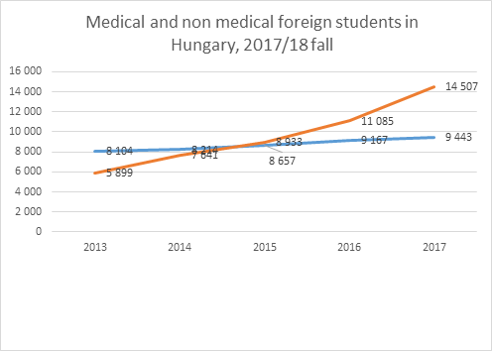
Medical
Non-Medical

Slide 10
Czech republic

Slide 11
Czech IHE
No national IHE strategy
Embedded in the national HE strategy
Specific IHE strategy being contemplated
National IHE priorities
Internationalisation at home
Increasing outbound mobility
Currently at 10000, but stagnated
Credit recognition needs improvement
Recruitment of international degree-seeking students
Currently at 44000 (14% of student body), many from neighboring countries

Slide 12
Poland, Hungary and Czech Republic in the EAIE Barometer
Preliminary findings
Notes:
Total: 2317
Czech Republic: 46
Hungary: 58
Poland: 74

Slide 13
EAIE Barometer in Short
2nd edition of a major study into European IHE
Survey conducted in 2017
Views of practitioners
Only from HE institutions
Covers the whole European Higher Education Area (48 countries)
2317 individual responses
Full results launched at EAIE 2018, Geneva

Slide 14
Main Goal of Internationalisation - Top Three

Slide 15
How does your HEI's level of internationalisation compare to others in your country?

Slide 16
Priority activities within respondent's HEI internationalisation strategy - Top Five

Slide 17
Institutional Organisation of IHE

Slide 18
Future of internationalisation at your HEI?

Slide 19
Conclusions
Internationalisation can thrive even under politically challenging context
However, risks associated with perceptions
Student mobility, recruitment of students, research partnerships
EAIE: Initial success with the 3 countries
KPIs already met in large part
Sustainability of activities will be an issue
Internationalisation still progressing, but for how long

