Slide 1
Creating a Sustainable Initiative for International Interculturalization
Todd Odgers, BCIT
Heather Tobe, Douglas College

Slide 2
Agenda
Foundations of institutional interculturalization
Case Studies
Moving Forward

Slide 3
Question 1
I’ve worked in international education for ____ years
1-3
4-8
9-15
16-20
21+

Slide 4
Question 2
My role is:
Senior leader
Head of international education
International education staff
Recruitment and retention
Faculty

Slide 5
Question 3
I would rate my understanding of interculturalization as:
thorough
good
somewhat
limited
I am here to learn

Slide 6
How does an institution negotiate cultural differences?
Interculturalization
Internationalization
Domestic diversity and inclusion
Indigenization

Slide 7
Interculturalization’s Stakeholders
Inclusive Interculturalization
International
Newcomers
Indigenous
Domestic Heritage Cultures

Slide 8
Intercultural Education
“Intercultural education, as opposed to international education, is a more inclusive formulation, in that interculturality includes both international and domestic students.
All students, regardless of their location, need to develop the capability to contribute in the intercultural construction, exchange and use of knowledge.”
Crichton et al 2004

Slide 9
Thoughts on Integrating…
“Universities need to be devoting energies to integrating the home student to the university as an international/ multicultural community, rather than focusing so exclusively upon integrating the international student into an Anglo-centric community”
Killick, 2010

Slide 10
Intergroup Contact Theory
Groups from different cultures must be appropriately prepared to interact.
If they are not, then a reinforcement of stereotypes and prejudice is likely to occur.
(Allport, G. W., 1954; Pettigrew, T. F., Pettigrew & Tropp, L. R., 1993, Sindanus et al., 2008)

Slide 11
Case Study 1

Slide 12
Question 4
Is intercultural learning part of your strategic plan?
Yes
In some areas
No
I don’t know

Slide 13
Question 5
To what degree is interculturalization considered in program development
Major
I think most programs address it
Somewhat
Very little
Don’t know

Slide 14
Question 6
Do you have benchmarks or evaluation methods for measuring campus interculturalization?
Yes
In some areas
No
I don’t know

Slide 15
NQ Timeline
2009-12
AR project
2012-13
Intercultural training
2012-17
Inclusion initiative
2017 +
Ongoing
Notes:
Point 1: AR project – Question “In what ways might Student Services enhance their interactions with diverse students to foster inclusivity?” - Perspective taking – point of entry for students to College – Created Inclusive Student Engagement Model for Action – Inclusion = Diversity + Engagement.
Finding: Inclusion and exclusion is a matter of perspective.
Point 2: Inclusion training – developmental – DMIS and practice perspective taking as an intercultural competence
Inclusive service interaction norms.
Point 3: Inclusion organizational map – holds multiple perspectives of inclusion – clarifies focus for inclusion strategies – makes inclusion more visible over time – filled in organizational strategy for inclusion – included Organizational performance metric, staff performance review tool, College activities – Inclusion Fusion, internal communications.
Point 4: Ongoing Inclusion activities to continue to influence College culture – Center supported and other departments (e.g. Student Navigator – Student Services, Human Library – Library, integration of intercultural competence curriculum in programming areas – Health, Language Training)

Slide 16
NQ Model for Inclusive Intercultural Education
Inclusion = Diversity + Engagement
Louw and Whitelaw

Slide 17
Frameworks

Slide 18
Using the AQAL- Ken Wilber
Subjective
Objective
My Values
Internal experience
Purpose
What we do
Measurable actions
Our activity and processes
Our Culture
How we act together
How we/I feel and talk about us
Systems
Policies
Micro
Macro
Notes:
Beneath Inclusion equation – framework - Quadrants – Integral theory – simplified and applied as a frame or map to hold inclusion as a phenomenon that is dynamic, complex and inter-related.
Review quadrants – following numbers.

Slide 19
Hammer
Notes:
E
None of the stages are good or bad in and of themselves- they all have strengths, even if they are not the most developed in terms of intercultural sensitivity

Slide 20
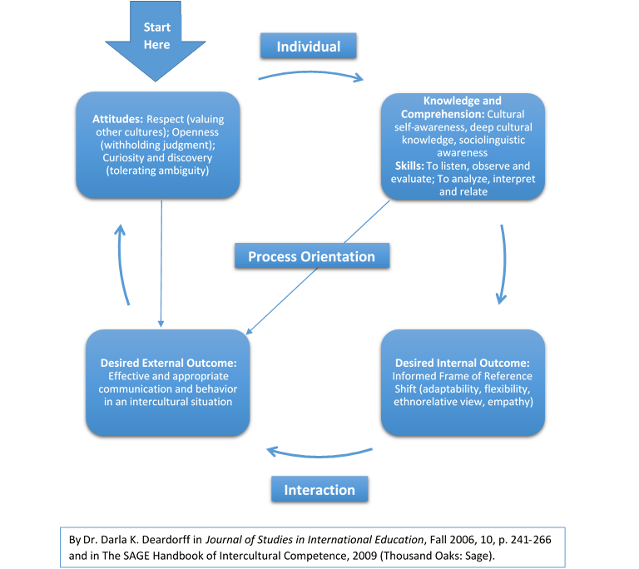
Deardorff: Process Model

Slide 21
Align, Shape and Engage All Quadrants and Stakeholders
Executive Contribution Agreements (LR)
Senior Leaders, Faculty, Staff, Targets (LR/UR)
75% with satisfactory intercultural competence
5 year strategy
Inclusion Engagement Scale (LR/UR)
Evaluating learning transfer
Benchmarking
Capturing Innovation

Slide 22
Align, Shape and Engage All Quadrants and Stakeholders- Cont’d
PLAR Framework for Faculty and Staff Hires (LR/UR)
Onboarding
Organizational development
Recognition and leveraging
College Wide Learning Outcomes Fwk (UL/LL/LR)
Inclusive Culture
Creative and Critical Thinking
Community Citizenship
Communication and Collaboration
Our Values in Action-”The Learning Experience” (UL/LL/UR)
College Brand- “50 Years of Inclusion” (LL)

Slide 23
Interculturalization -Organisational Development
Senior level buy-in and championing
Align with the strategic plan and vision
Process for engagement
Baselines, benchmarks and targets
Capture artifacts of learning and change

Slide 24
Case Study 2

Slide 25
Question 7
To what extent is interculturalization a focus in learning outcomes in your institution
Major
I think most programs address it
Somewhat
Very little
Don’t know

Slide 26
Question 8
Interculturalization is part of the staff/faculty pro d
Totally agree
Agree
Somewhat agree
Disagree
Totally disagree

Slide 27
Question 9
Interculturalization discourse is included in discussions around academic integrity
Totally agree
Agree
Somewhat agree
Disagree
Totally disagree

Slide 28
Question 10
Interculturalization is fully embedded in my institutional orientation programs for both international and domestic students
Totally agree
Agree
Somewhat agree
Disagree
Totally disagree

Slide 29
DC Timeline
Late 1990’s
Early 2000’s
Late 2000’s
Present

Slide 30
Douglas College
Faculty strategies/initiatives:
1997
BCCIE/BC Ministry of Education, Skills and Training, BC institutions: Best Practices Guidelines for Internationalizing the Curriculum

Slide 31
Faculty strategies/initiatives:
2000
BCCIE/ Douglas College: Internationalizing Learning Project
Associate of Arts in Intercultural and International Studies
Intercultural course development

Slide 32
Faculty strategies/initiatives:
2005
Academic/Strategic Plan: Academic signature – set of 9 core competencies or essential skills provided in all programs
Intercultural Communication

Slide 33
Creating the shift
Interculturalization as core
Awareness building
Increased strategies/initiatives
Professional development
Curriculum development

Slide 34
Deardorff: Process Model
Notes:
Duplicate this slide via copy and paste to create more slides with images.

Slide 35
What we can learn from these case studies?
Frameworks
Sustainability
Systems
Gaps to address
Organizational shift

Slide 36
Discussion
What is something you learned today that interests you?
What could you apply from today’s presentation to your own context?

Slide 37
Any questions?
Heather Tobe
tobeh@douglascollege.ca
Todd Odgers
todgers@bcit.ca
Notes:
Please remember to add your contact information!

Slide 38
References
Deardorff, D. (Ed.)(2009) SAGE Handbook of Intercultural Competence, CA: Sage

