Slide 1
Technology and Education: Trends, Influences and Disruption

Slide 2
1. Evolution 2. Policy 3. DEMOGRAPHICS 4. DISRUPTION/ INNOVATION 5. challenges 6. FUTURE landscape

Slide 3
A DEFINITION
Educational technology includes a dynamic system of study, and moral action, with the aim of specifying and providing an interactive environment for learners’ activity for their fast, easy, durable education and learning in harmony with their interests and characteristics.
Jafar Ahmadigol, Department of Education and Psychology, University of Kharazmi of Tehran, Iran

Slide 4
1. EVOLUTION
The e-learning timeline (Conole 2013)

Slide 5
1. EVOLUTION

Slide 6
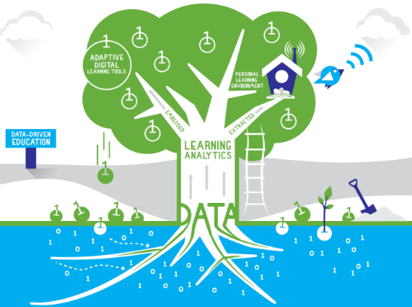
1. EVOLUTION

Slide 7
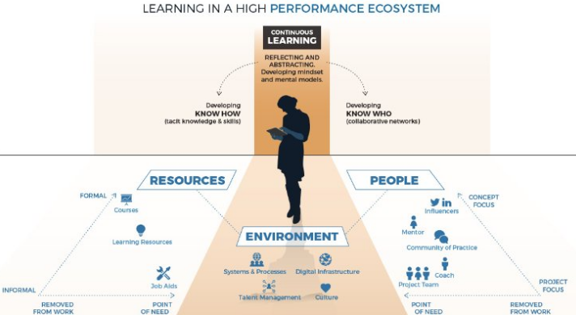
1. EVOLUTION

Slide 8
2. Policy
India
Tertiary Education institutions
700
Population 18 – 24 yrs
230 million / 20%
Gross tertiary enrolment ratio
23.9% (est. 2013)
Internet penetration
26%
The Unites States
Tertiary Education institutions
4,140
Population 18 – 24 yrs
30.6 million / 10%
Gross tertiary enrolment ratio
86.7% (est. 2015)
Internet penetration
74.6%

Slide 9
2. Policy
India
National Mission on Education Through Information and Communication Technology
“For India to emerge as a knowledge super power of the world in the shortest possible time it is imperative to convert our demographic advantage into knowledge powerhouse by nurturing and honing our working population into knowledge or knowledge enabled working population”
Enhancing the Gross Enrolment Ratio in Higher Education by 5 percentage points during the XI Five Year Plan period.
Three cardinal principals; access, equity and quality
Enabled by the policy environment
Low cost, affordable devices
High quality e-content free of cost
Student profile; urban, rural and lifelong learners

Slide 10
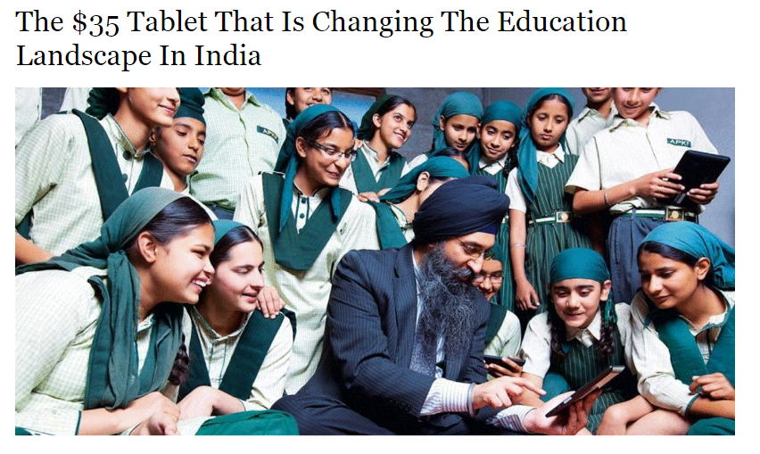
2. Policy

Slide 11
2. Policy
USA
National Education Technology Plan; Reimagining the Role of Technology in Higher Education
“Higher education has never mattered so much and to so many as a means of social mobility, an engine of economic growth, and a defender of democracy. In order for higher education to fulfill its promise as a great equalizer, we need continued innovation that can move us toward increased access, affordability and equity. This innovation will develop an ecosystem that will include a range of opportunities for a variety of high-quality educational experiences and credentials with marketplace value suited for the differing needs of students”
Student profile; ‘New Normal’ students in Higher Education
Transforming the ecosystem; teaching, learning and assessment
Systems that support student success
Enabled by the policy environment

Slide 12
2. Policy

Slide 13
2. Policy
India and the US – Policy synergies
Access
Equity
Affordability
Quality
Longevity
Scale

Slide 14
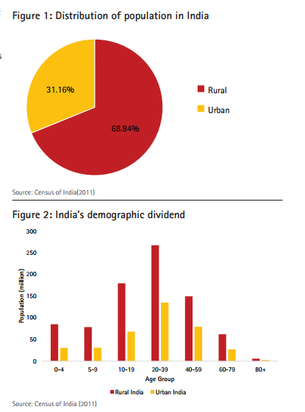
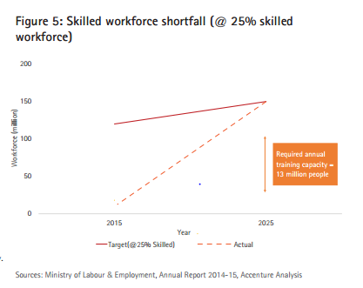
3. DEMOGRAPHICS
‘India’s demographic position is unparalleled’

Slide 15
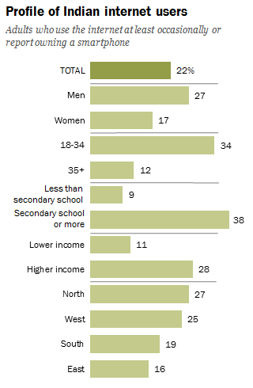
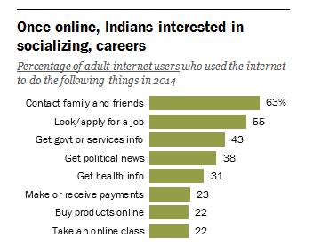
3. DEMOGRAPHICS

Slide 16
4. Disruption/ innovation
TRANS-NATIONAL EDUCATION (TNE) from the UK
More students study outside in the UK with UK institutions
There are only 15 countries in the world where the UK does not offer any HE TNE
Four in five higher education institutions (HEIs) intend to expand their TNE provision over the next 3 years
TNE provides opportunities for external expansion but also internal review. This can strengthen the core capacity and capability of an institution

Slide 17
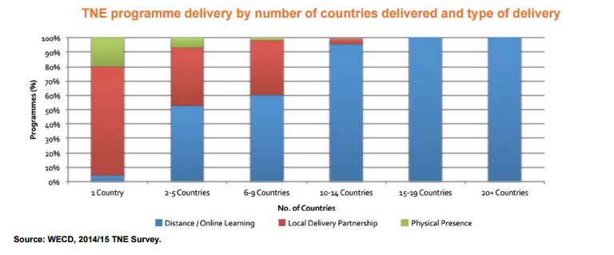
4. Disruption/ innovation
UK

Slide 18
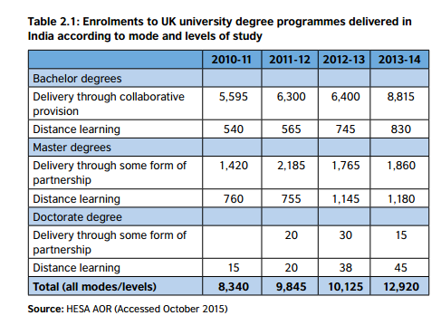
4. Disruption/ innovation
Notes:
E-QUAL
https://drive.google.com/drive/folders/0BwnYWEP8oDD8ckRPNVE3TjFwN0U

Slide 19
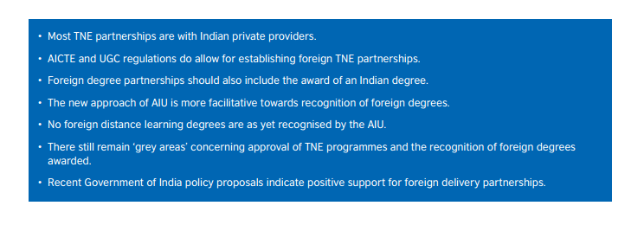
4. Disruption/ innovation
India - The policy and regulatory environment for TNE

Slide 20
5. challenges
Learning style and cultural challenges Unique, individual and difficult to identify
Pedagogical challenges Skills gap for many educators
Technological challenges Bugs, speed, functionality, reality

Slide 21
5. challenges
4. Technical training challenges Pace of development
5. Time management challenges Speed, reach and quick response expected
6. Financial challenges High costs to deliver on the ambition

Slide 22
6. FUTURE LANDSCAPE
Moral action; will policy aspirations be met?
Technology opens the potential and provides opportunity to improve student outcomes and lower costs. We should work to ensure that students who have been historically underserved and are currently not well-served benefit from all of these opportunities
Will policy makers keep up with the pace of change?
We must conduct more research that tests effectiveness and informs practice. It is vital that the on-going innovation that contributes to the higher education ecosystem is supported by research and builds a strong evidence base for technology-enabled learning
Equity via access
Ensure online education does improve learning outcomes and doesn’t increase inequity of opportunity by creating types of learners and learning outcomes

Slide 23
thank you
elizabeth.shepherd@britishcouncil.org

