Slide 1
EDUCATION IN CANADA
A World of Possibilities Awaits
Notes:
Note to presenter:
Let the audience know who the presenter is and the purpose of the presentation
During the presentation, the presenter can engage the audience by asking which province they know and/or would like to go to - showing some of the EduCanada videos
Confirm / identify who the audience is by using questions such as:
Has anyone already been to Canada?
Who is looking for this (name the type) program/level of education?

Slide 2
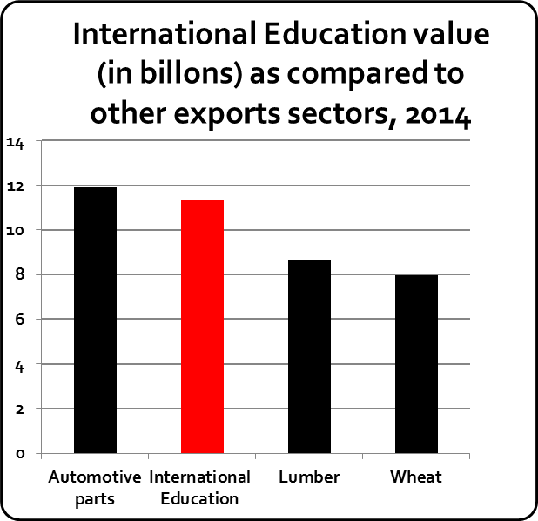
International Education is a Growth Sector
Major service export, in 2014:
326,425 students spent $11.4bn
generates $2.1bn in tax revenues
sustains 123,000 jobs
$9.3bn in GDP contribution
Addresses skills and demographic gaps across Canada
Improves Canada’s competitiveness via R&D, innovation and commercialization.
Source: 2016 Economic Impact of International Education in Canada – An Update. Roslyn Kunin & Associates, Inc.

Slide 3
That’s why we created an International Education Strategy
Key IES Objectives:
Double # of international students to 450,000+ by 2022
Promote Canada as world-class study and research destination
Key Elements of the IES:
Integrated Marketing Plan - Brand Refresh & Digital Strategy
Leveraging International Scholarships to promote Canada as top study destination
Targeting priority, established, and emerging markets
Coordinating with provinces and territories, industry, and other federal entities

Slide 4
Major Milestones
EduCanada brand launched Feb. 2016
110 missions and over 300 events (e.g. recruitment fairs)
On track to reach target of doubling # international students
Building foundation for robust digital marketing strategy

Slide 5
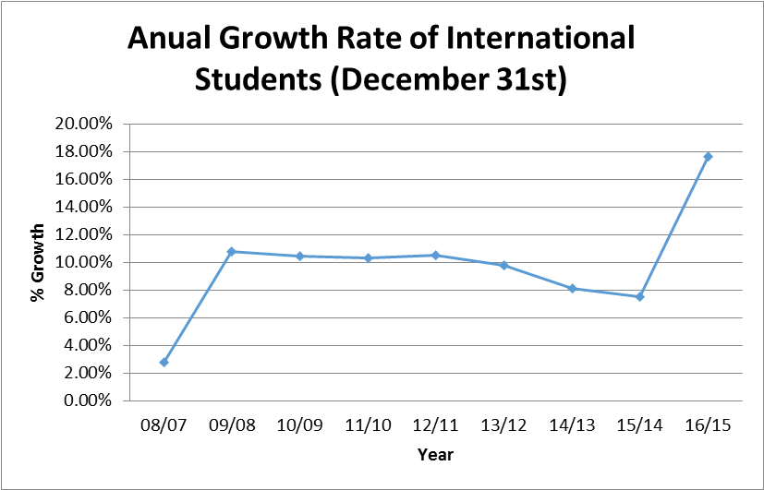
IRCC Data Trends
Facts:
414,285 international students in Canada on December 31st, 2016
18% increase from 2015 #s
Source: IRCC Data, May 2017

Slide 6
Top 10 Source Countries
Top 10 Source Countries: Change in Number of Students (Year End Data)
Country of Citizenship | 2015 | 2016 | Change in Number | % Change | % of Total Increase
China | 117,545 | 131,995 | 14,450 | 12% | 23%
India | 48,515 | 76,370 | 27,855 | 57% | 44%
Korea | 19,695 | 21,290 | 1,595 | 8% | 3%
France | 20,065 | 20,720 | 655 | 3% | 1%
United States of America | 12,150 | 12,885 | 735 | 6% | 1%
Nigeria | 9,915 | 10,760 | 845 | 9% | 1%
Brazil | 7,305 | 9,230 | 1,925 | 26% | 3%
Saudi Arabia | 11,650 | 9,110 | -2,540 | -22% | -4 %
Japan | 7,090 | 7,790 | 700 | 10% | 1%
Vietnam | 4,855 | 7,505 | 2,650 | 55% | 4%
All Countries Total | 351,330 | 414,285 | 62,955 | 18% | 100%
Source: IRCC Data, May 2017

Slide 7
TRADE COMMISSIONERS AT BCCIE
Mandeep Gill – Regional Office, BC & Yukon
Marilène Gourdeau-Bussière – China
Megumi Akiyama – Japan
Verónica Soto – Mexico

Slide 8
Notes:
Nous allons faire notre présentation en Anglais, mais cette présentation est disponible en français. N’hésiter pas à me poser des questions en français.

Slide 9
What is the TCS?
The TCS can help you to:

Slide 10
What is the TCS?
TCS clients
Are part of the Canadian business community
Have meaningful economics ties to Canada
Contribute to Canada's economic growth
Have a demonstrated capacity for internationalization

Slide 11
What is the TCS?
TCS four key services
Preparation for international markets
Market-potential assessment
Identification of qualified contacts
Commercial problem solving

Slide 12
Preparing for International Markets
Trade Commissioners in Canada help companies and organizations refine their export strategy
assess whether they are export-ready
decide on a target market
connect them to the TCS Network abroad
disseminate relevant business leads
“The TCS is almost an extension of our business. They aren’t employees; they’re a part of our company.”
Bob Thomas, Progeny Software, Wolfville, Nova Scotia

Slide 13
Assessing Market Potential
Trade Commissioners abroad help companies and organizations implement their export strategy
share local market intelligence
identify local risks & mitigation strategies
advise how to improve local market penetration
“The TCS took the time to understand our technology and then helped us with a market-entry approach. This saved us time and money!”
Nelson Dass, ALTINEX, Mississauga, Ontario

Slide 14
Finding Qualified Contacts
Global reach
The TCS has contacts abroad that can provide the local knowledge Canadian companies and organizations need to succeed.
Canadian presence
The TCS can link companies and organizations to the vast Canadian trade network, trade missions, and advise on trade fairs and other events.
“The TCS are well-respected by contacts around the world. When the TCS introduces us to a potential client, that’s one of the best references we can have.”
Marc St-Onge, TelcoBridges, Boucherville, Quebec

Slide 15
Japan: Recruitment and Partnerships
Japan
Canada is popular destination for Japanese students (#2: ESL/FSL, #9; Study permit)
Recruitment opportunities for all levels of education
Partnership opportunities and exchange agreements

Slide 16
Japan: Top Study Destinations
Japan
Rank | Country | Market Share (2014)
1 | United States | 25.5%
2 | Australia | 19.4%
3 | Canada | 14.4%
4 | United Kingdom | 11.6%
5 | New Zealand | 8.0%
Source: Japanese Association for Overseas Studies, 2016

Slide 17
Language Programs (ESF/FSL)
Japan
Source country | 2013 | 2014 | 2015
Brazil | 17,656 | 20,128 | 19,865
Japan | 17,990 | 20,081 | 19,618
China | 14,426 | 17,685 | 17,093
South Korea | 14,100 | 15,571 | 15,761
Saudi Arabia | 11,162 | 10,497 | 9,080
TOTAL | 129,704 | 137,416 | 133,910
Source: Languages Canada
Source: Languages Canada Survey 2016
Top Destinations by Province
British Columbia 10,296 (52.5%)
Ontario 6,522 (33.2%)
Alberta 1,372 ( 7.0%)

Slide 18
Japan
Japan: Market Trend - Opportunities
Significant Japanese government investment in internationalization of education through 2020 (22,000 outbound and 6,000 inbound scholarships)
Short-term programs (<1 year) main opportunity; recruitment for degree programs less so
Academic and exchange partnerships a key vehicle for student recruitment
English-language degree programs in non-traditional subjects on the rise
Notes:
Top Global University Project
Partnerships and exchange agreements
Youth mobility – IEC Quota of 6,500 in 2017
Sister-city relationships
Tokyo 2020 Olympic & Paralympics
Non-degree and one-year study abroad programs
Japanese Scholars
Scholarships for Degree Courses
1 or more years for undergraduate, master’s or Ph.D.
FY 2017: 0.7 billion yen, 297 students
Approximately CAD$ 900-1,500/month
Scholarships for Short Courses
For short-term study abroad (less than 1 year) under exchange agreement
FY 2017: 5.8 billion yen, 22,000 students
Approximately CAD$ 700-1,100/month
TOBITATE! Young Ambassador Program
Private-sector funded for study abroad up to 2 years
~1,000 students per year
High school (application through schools) and PSE level
Scholarship Programs for Japanese Students
MEXT Scholarships
Mainly graduate school level (full degree)
FY 2017: 18.7 billion yen, 11,276 students
Approximately CAD$ 1,200/month
MEXT Honors Scholarships for Privately Financed Students
1-year grants for students with good academic records
FY 2017: 3.9 billion yen, 8,070 students
Approximately CAD$ 550/month
Student Exchange Support Program
For students on exchange programs (less than 1 year)
FY 2017: 1.6 billion yen, 6,000 students
Approximately CAD$ 900/month

Slide 19
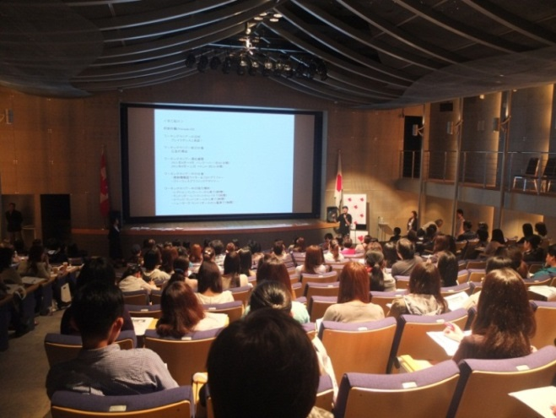
Japan
Japan: Market Entry Consideration
Our Tools to Serve You
Contact lists:
Education agents, schools, service providers
Market reports and statistics
Matchmaking services
Embassy facilities
Promotional events:
Fairs, workshops, info sessions

Slide 20
Japan
Japan: 2017/18 Education activities
EduCanada Fairs – Fall 2017 (Tokyo & Osaka) in November
Tokyo: November 2 & 3
Day 1: B2B meetings & Recruitment Fair
Day 2: Recruitment Fair
Osaka: November 5
Recruitment Fair
EduCanada Fair – Spring 2018 (Tokyo) Mid-March
Day 1: B2B meetings & Recruitment Fair
Day 2: Recruitment Fair

Slide 21
China: Now is the time to come
China
2016: 544,500 Chinese students abroad - 132,000 to Canada
2017: estimated to be 600,000 students abroad
Canada is #4 for study destination
According to IELTS research, Canada #1 at attracting students under 18
Notes:
#2: ranking order US, UK, AUS, CAN
US, UK and AUS entered much earlier than CAN; they have a head start and are more competitive in general + they have a federal education Ministry
#3: Trends of younger kids going abroad to study K-12, summer/winter camps, Beijing Winter Olympics 2022
#4: MOU on Education Cooperation – provinces (CMEC) were involved in consultations before signing. Allows Chinese public institutions to travel/spend $ to engage with Canadian institutions
Renewal of the Canada-China Scholars' Exchange Program
Canada being named the Country of Honour at the 2017 China Education Expo
Expansion of the Canada Learning Initiative in China Program, a partnership to help Canadian students to gain experience in China as part of their degree program.
Rising Chinese middle class, particularly in 2nd and 3rd tier cities
Chinese families only target small number of big cities “MTV” and best ranked universities
Room to grow, especially as we need to diversify in cities, regions, programs, etc.

Slide 22
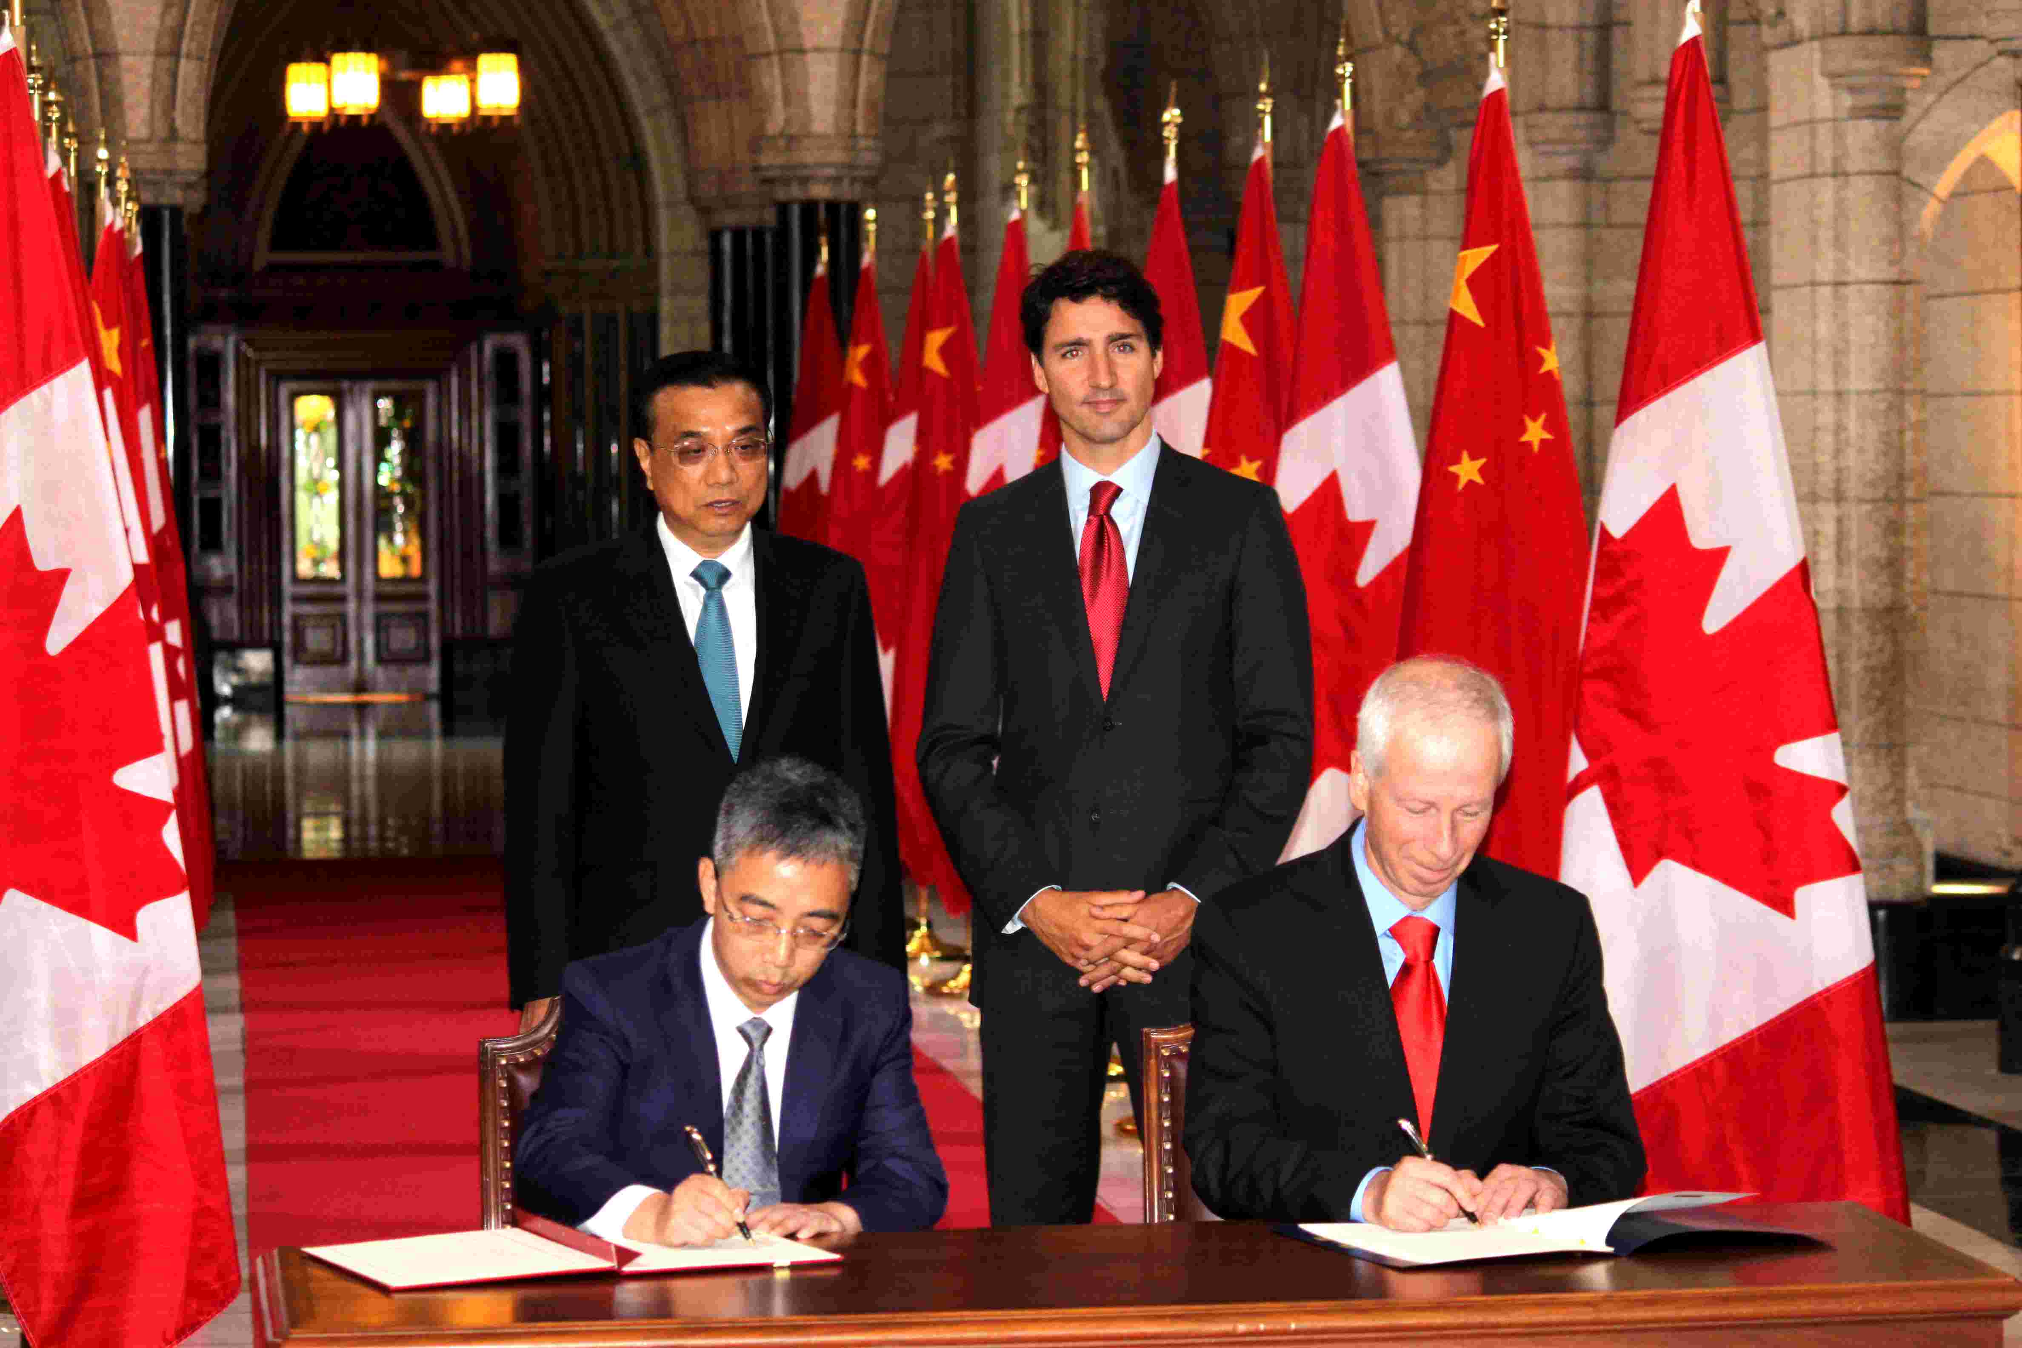
China
2016: Canada and China sign MOU on education

Slide 23
China: Market Entry Considerations
China
Have a China strategy and commit to it
Invest in the long term, both time and money, build relationships
Have a local presence or local representatives
Focus your efforts on a few regions
Consult the Trade Commissioner Service
Notes:
#1: most common mistakes: slow response, no follow up, don’t take into account culture differences, lack of resources, no specific plan towards China market
#2: most common mistakes: only focus on recruitment of students, don’t pay attention to institutions exchanges, don’t consider sending more Canadian students
Can consider recruiting from vast network of Canadian curriculum schools
#4: China is a big country, many regional markets. Build up capacity in a few geographic areas rather than trying to be everywhere.

Slide 24
China: Recent Trends and Updates
China
From last Chinese education 5-y plan:
Build more international campuses in China
Upgrade 1-tier universities
Establish new sister-school relationships
Increase students and teachers exchanges
Promote short term programs (summer/winter school, camps)
Encourage training for teachers, leaders, and the corporate world
Notes:
#1.2: Schools will be heavily funded to improve facilities, research as well as international exchanges
#1.4: both ways, including more Canadian students/teachers to China; Canadian students in China 3,846

Slide 25
China: 2017/18 Education Activities
China
Cross-China Roadshow:
Oct. 2017 – China Education Expo (CEE) and China Annual Conference on International Education (CACIE) – Canada Country of Honour + CMEC engagement
Oct. 14-15, 2017 – EduCanada Fair in Hong Kong
Mar. 2018 – China International Education Exhibition Tour (CIEET)
Our network:
Beijing, Shanghai, Guangzhou, Chongqing, Hong Kong, Taipei
10 Canadian Trade Offices mainland China
Notes:
#1.1: Beijing, Shanghai, Guangzhou and Chengdu. Side activities to be added depending on posts (B2B, info session, etc.)
BJ - China Annual Conference on International Education (CACIE) + delegation of 8-9 Ministers representing 7-8 provinces (high visibility) + delegation of institutions (19 presidents of universities, 60+ colleges, etc.)
Others:
BJ - Canadian MBA Education Fair in Beijing (Sept 2017)
BJ - PhD Workshop 2017 (Nov 2017)
BJ - Vocational Fair in Beijing (March 2018)
SH – Vocational training seminar (Oct. 2017)
SH - Education Seminar in partnership with EY (Nov. 2017)
CQ - EduCanada Booth at Yunnan Education Expo (June 2017)
#2.2: in 2^{-tier} cities, smaller, 5-10 million

Slide 26
Mexico: Recruitment and Partnerships
Mexico
Canada #4 destination for Mexican students
Mexico remains the second most important source in Latin America for international students in Canada
Recruitment opportunities are high for ESL, K-12 and colleges, follow by universities undergraduate and postgraduate programs
Partnership opportunities:
Expanding K-12 institutional linkages on teacher training, ESL and student and teacher mobility
Universities and colleges benefit from more innovative agreements (research collaboration, teacher and student exchange, double degrees, teacher training and language training)
Local governments for ESL/leadership programs, innovation, etc.
Notes:
# of Mexican students in Canada - 2015: Long term 5,140 short term 8,260
Recent partnership agreements between Canadian and Mexican key stakeholders: CONACYT, ANUIES, SEP, Languages Canada, Universities Canada, MITACS and CALDO.

Slide 27
Mexico: Recent Trends
Mexico
Visa-lifted in Dec. 2016: An increase is expected in students enrolled in short-term programs
Opportunities in medium-size cities: Merida, San Luis Potosi, Veracruz, Leon, Cancun, Villahermosa
Spanish is the language of promotion in the Mexican market
Education agents play an important role for recruitment for K-12 and language programs

Slide 28
Mexico: Market Entry Considerations
Mexico
​Mexico has more than 33 million students country wide
Education is a priority for the Mexican Government
Exchange rate: USD vs. MXP/ CAD vs. MXP​
Expanding institutional linkages​
In person visits. At least one trip per year is required to establish relationship and remain connected to the market

Slide 29
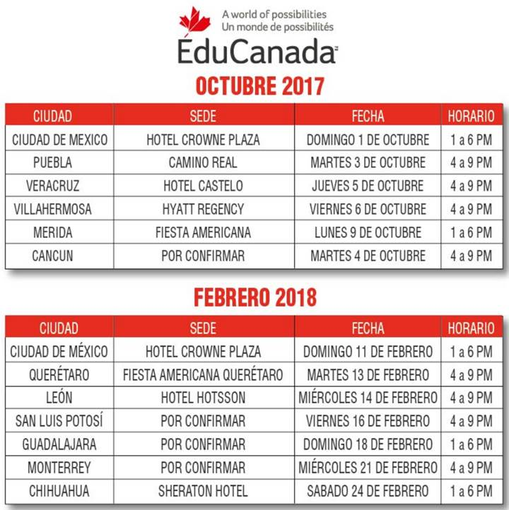
Mexico: 2017/18 Education Activities
Mexico

Slide 30
Questions or Comments?

Slide 31
(Don’t forget your B2B)
Thank you!
Connect with the TCS
tradecommissioner.gc.ca

