Slide 1
International Students Orientation: technology, partnerships and Canadian student participation
Kate Jennings Vancouver Island University
Enrique Chacon Vancouver Island University
Laura Prada UBC Okanagan
Notes:
This is a PowerPoint template designed for BCCIE Summer Conference 2017 presentations. Please customize the slides to suit your presentation needs.
Header Font: Arial
Text Font: Arial
Eastern Blue: RGB 15 134 152
Light Sea Green: RGB 48 187 165
Cobalt: RGB 18, 83, 168
If you have questions about this template, please contact Vivien Lee (Coordinator, Communications and Initiatives) at vlee@bccie.bc.ca with subject header [2017 Summer Conference Template – Name]
---
Colour names source example: http://www.htmlcsscolor.com/hex/1253A8

Slide 2
Agenda
Pre-arrival: "Ready, Set, Go"
Orientation: Smooth Sailing
Canadian Students

Slide 3
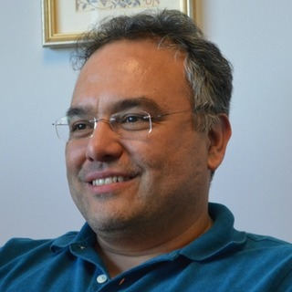
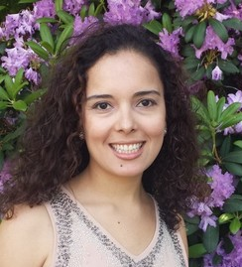
Enrique Chacon Senior International Student Advisor, Vancouver Island University
Hello
Kate Jennings
Director, International Student Services, Vancouver Island University
Laura Prada
Manager, Curriculum and Academic Programs, UBC Okanagan
Notes:
SELF INTRODUCTION
Change presenter photo
Double click on the photo
In the navigation panel (top bar), in the “Adjust” section choose “Change Picture”
Upload your own photo
**If there are more presenters, copy and paste the picture and repeat steps 1-3

Slide 4
UBC Okanagan
VIU
BC Map
Notes:
Location circles can be moved according to your needs. Select with your mouse cursor, drag and drop to desired spot.

Slide 5
International Student Orientation
Too much information, too little time

Slide 6
Giving them the information before they get here

Slide 7
International Ready, Set, Go - Launchpad to Success at VIU! Pre-arrival guide
Adapted from the online course created in 2015 for newly admitted domestic students several stakeholders (enrolment management, registration, advising, CIEL)
Built using Brightspace software by D2L Learning Management System "VIULearn"
This is an online onboarding site to help students

Slide 8
Where is the content coming from?
Reorganizing existing information into digestible and understandable bites for students
Team effort from different areas of expertise

Slide 9
"Orientation was fun but overwhelming, I don't remember half of the people that talked to us. Many things looked important, but I don't need them"
“

Slide 10
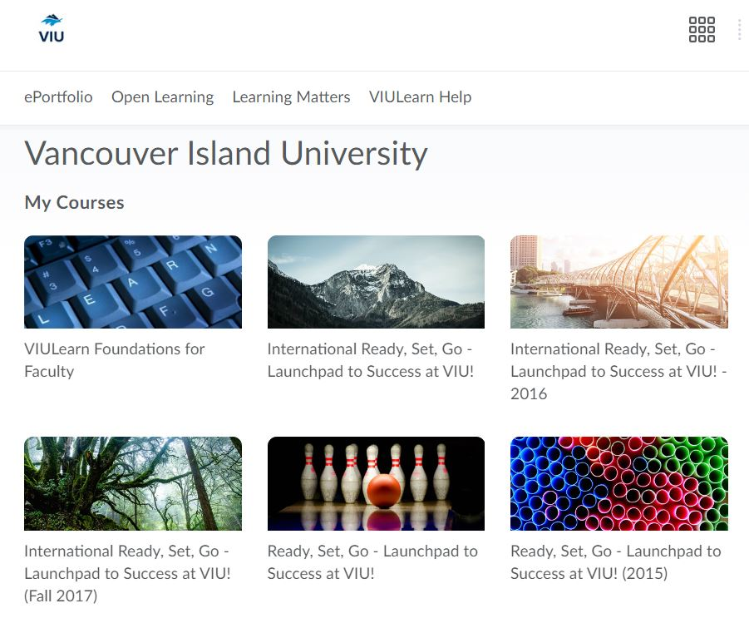
Portal
Notes:
Duplicate this slide via copy and paste to create more slides with images.

Slide 11
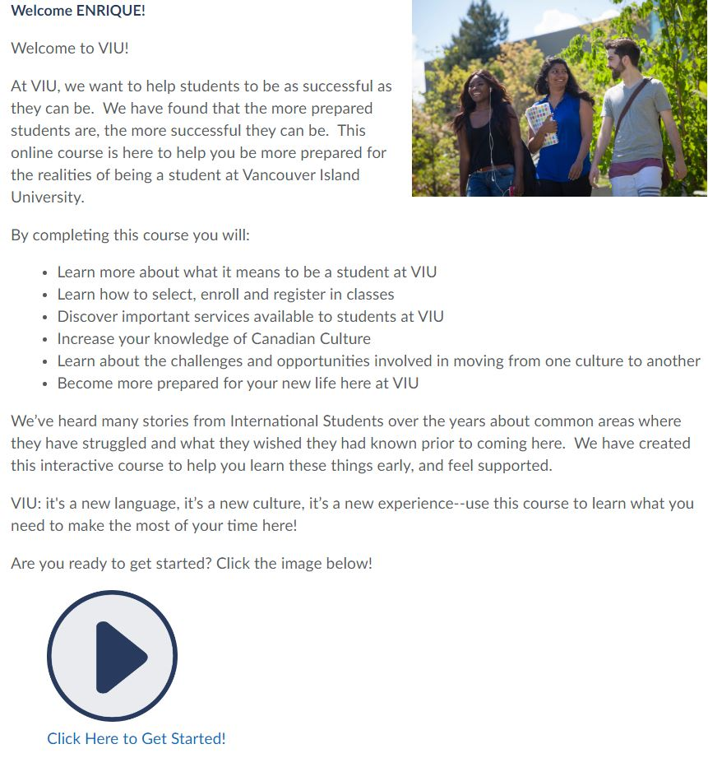

Slide 12
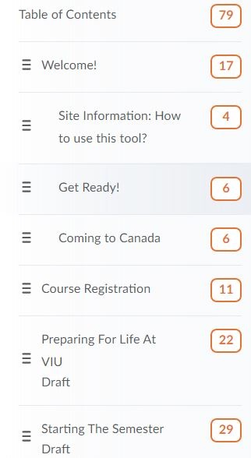
Getting Started
The first step to success in a site like this is to figure out how to navigate and find things.
First we will review, open, and navigate in pages, then at how to get back to this course the next time you need to login.
There is also a page with Tech Support information if you need some help.
To get started, click directly on "How to View Content on this Site" below to open that page!
Remember to check this space again in a few weeks to access all the exciting materials we have for you!

Slide 13
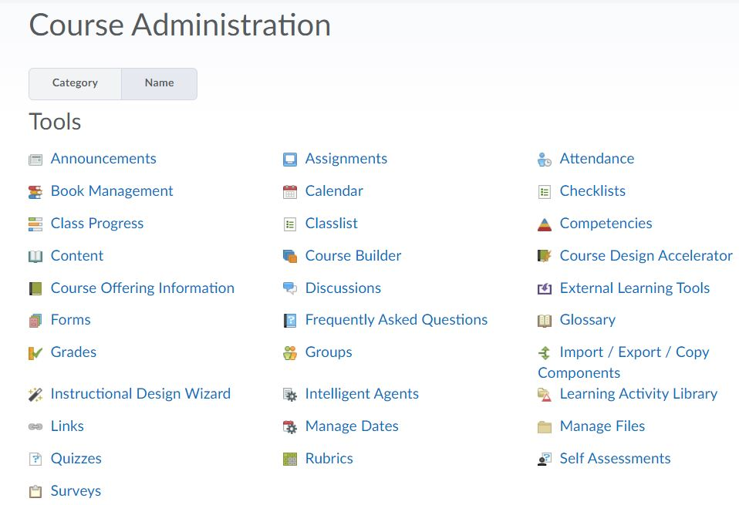

Slide 14
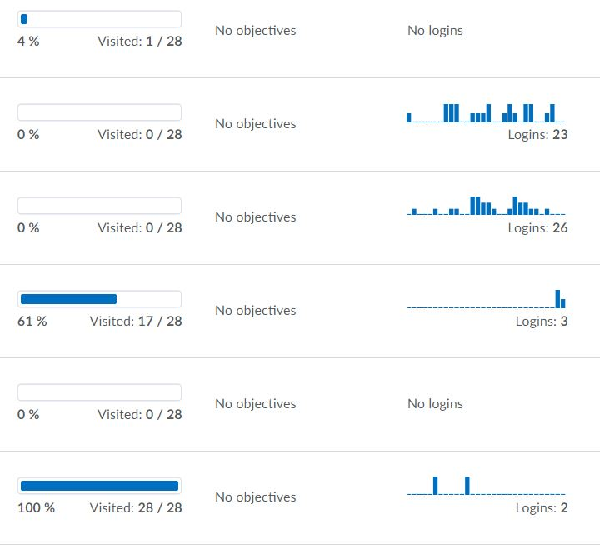
Analytics

Slide 15
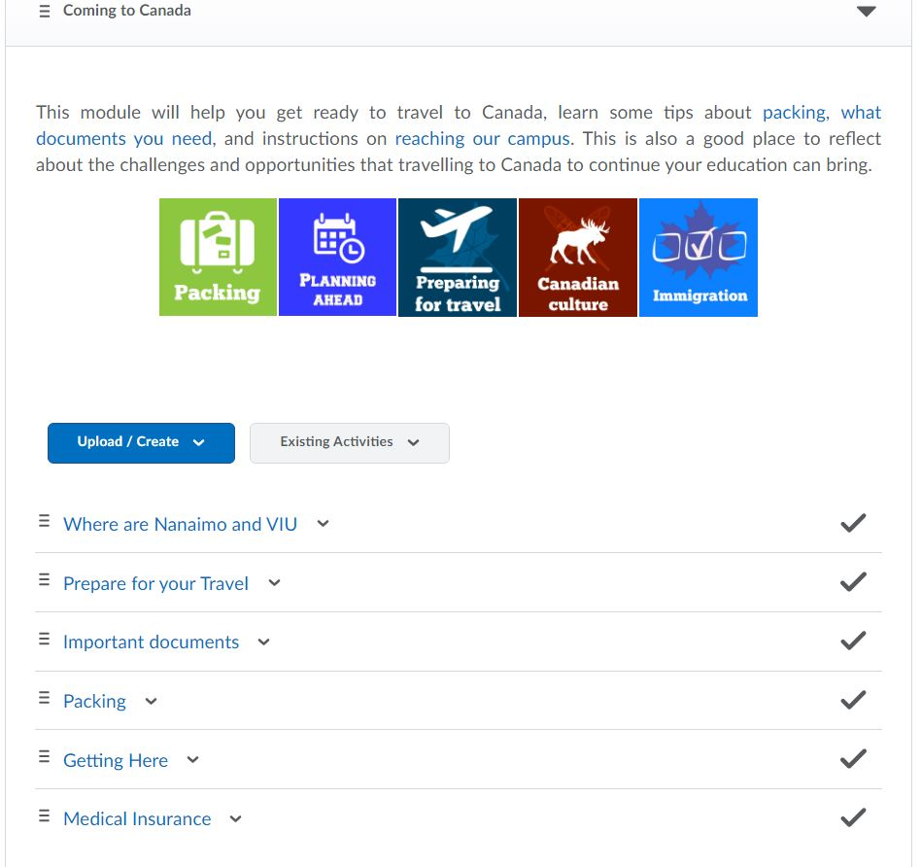
Analytics
Insert Text or Image
The course has three surveys that provides us feedback and ideas for improvement

Slide 16
Thank you
Any questions?
You can find us at
Kate.jennings@viu.ca
Enrique.chacon@viu.ca
Laura.prada@ubc.ca
https://international.viu.ca/iss
Notes:
Please remember to add your contact information!

